Slide 1





TAIWAN
MARKET ENTRY STRATEGY
OF
TEAM 3
106305015 Ansel
105509210 Jennifer
105305011 Sonia
106301072 Jane
105208043 Hazel
Notes:
Good morning to you all! We are Team 3 and I am Sonia
Before I start, I would like to clarify a Term we created called “OELP” which represents Online english learning platform.

Slide 2
Outline
Entering Taiwan Market
1. Demographics of respondents
2. Taiwan Market Overview
3. 2C Market Strategy
4. 2B Market Strategy
5. Conclusion
6. Appendix
Notes:
In today’s presentation, we would cover several sessions. From Taiwan market overview to 2B and 2C market. Last but not the least is our overall recommendation for Tella.

Slide 3

Demographics of respondents
Research Method
Result Profile

Slide 4
Demo-
graphics
Quantitative Research Method
Research method | Online Survey
Respondent | Willing to learn English
Medium | NCCU Facebook Public Group Friends and Colleagues
Sample Size | 236 / 262
Survey design | English proficiency and attitude assessment English learning preference Customer Journey Demographic
Notes:
Surveys are proven to be one of the most effective and trustworthy research methods
Screening question : Is Prof. Park a good teacher? And we asked the respondent to reply yes.
Finally we collected 262 questionnaire and 236 is valid.

Slide 5
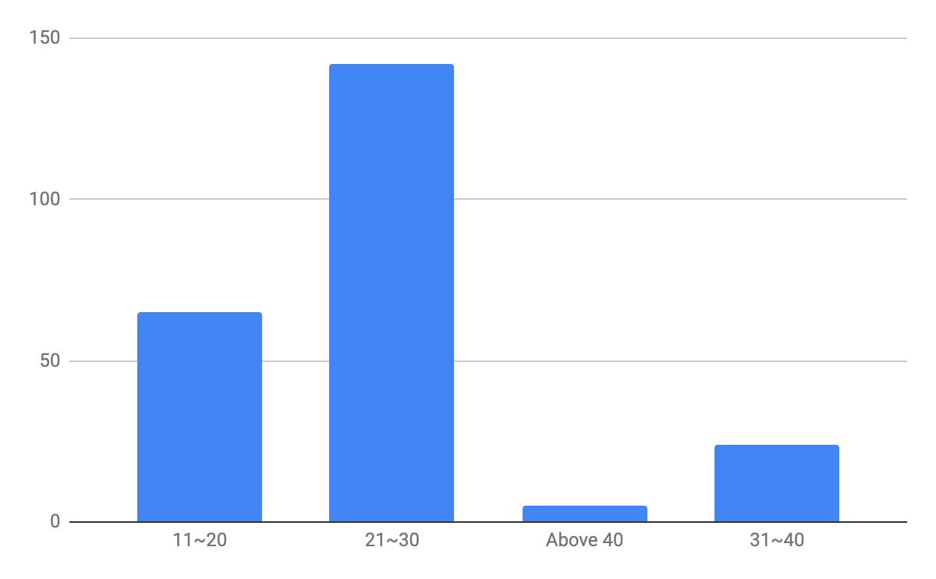
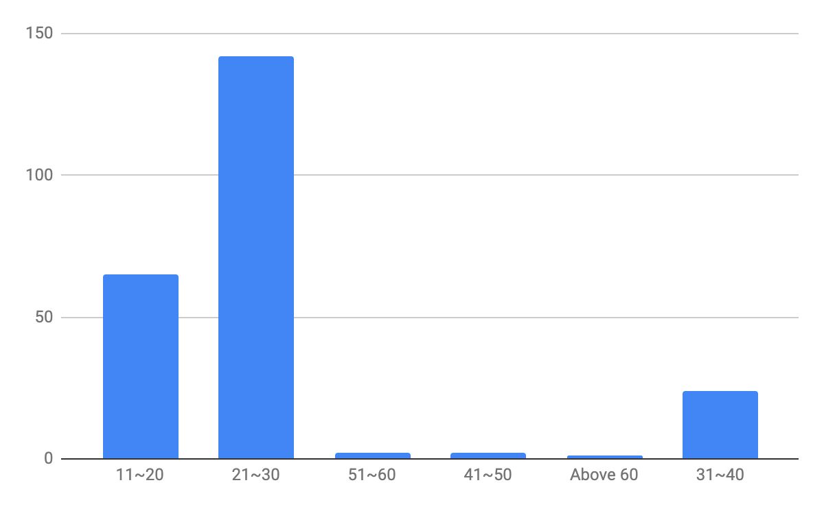

Demo-
graphics
Research Result Profile
Q.D2 GENDER Q.D1 AGE
67.8% are female
Combine 41~50, 51~60, Above 60 to Above 40
Notes:
表格：年齡
40歲以上並置

Slide 6
Taiwan
Market
Overview
External Analysis
Competitor Analysis
Pain Points In Taiwan
Tella’s Unique Selling Point

Slide 7
Is Taiwan worth to enter?
Yes! There’s an opportunity in Taiwan!

Slide 8
Taiwan Market Overview
External Analysis
Government promotes E-learning
Macro
Available of 5G technology in future years
2019 market scale of English learning in Taiwan is about
NT$50 billion ( =$ 1.67 billion USD).
Industry
Online English learning, with the growth rate of 10% per year, accounts for 20% of the English learning industry.
TOEIC in Taiwan is 554 (Korea: 673), anxious of speaking and writing
Customer
80% of all users is 21 to 40 years old.
Resources : Appendix
Notes:
Firstly, with government’s support, the market scale in 2019 is about 50 billion, in which OELP contribute 20% of it and is growing with 10% per year. That is to say, OELP becomes a trend and is growing rapidly. And, currently 80% of our user is around 20 to 40 years old. (According to TOEIC’s analysis, the majority’s english level is lower than Koreans)
macro1: http://teldap.tw/Introduction/introduction.html
macro2: https://www.ey.gov.tw/Page/5A8A0CB5B41DA11E/087b4ed8-8c79-49f2-90c3-6fb22d740488
industry1: https://www.digitimes.com.tw/iot/article.asp?cat=158&id=0000572200_faf3nf66lcl1vz1ykq1y5
industry2: https://meethub.bnext.com.tw/voicetube-%E5%85%AC%E5%B8%83%E3%80%8A2019-%E5%9C%8B%E4%BA%BA%E8%8B%B1%E6%96%87%E8%AA%BF%E6%9F%A5%E5%A0%B1%E5%91%8A%E3%80%8B%EF%BC%9A%E7%96%AB%E6%83%85%E5%B8%B6%E5%8B%95%E7%B7%9A%E4%B8%8A%E8%AA%9E/

Slide 9

Taiwan Market Overview
Willingness to use online platform
Q13. Are you willing to learn English by using online English learning platform?
N = 236
Option | Response
Yes | 163
No | 73
70.8% willing to learn English online
Resources: Our Survey

Slide 10
But...how about the competitors?
The competition is fierce.
But there’s no direct competitor.

Slide 11
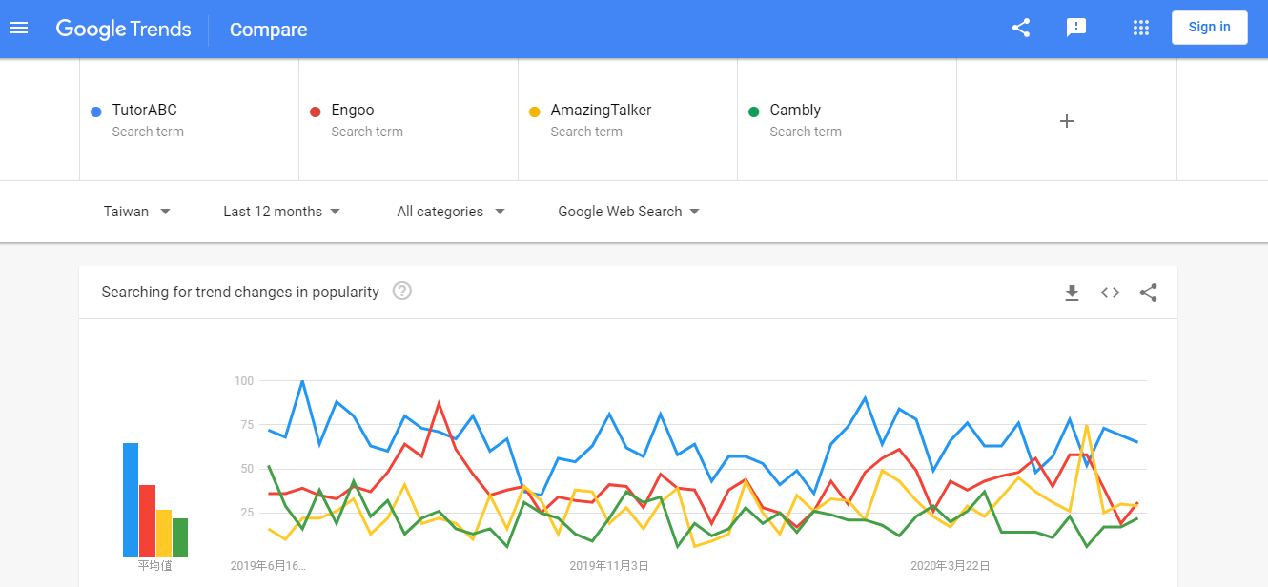
Taiwan Market Overview
Competitor Analysis
Notes:
Though there’s a big opportunity in Taiwan, we also have more than 20 OELP competitors. To identify our major competitors, we use google trends to evaluate the brand awareness and come up with 4 competitors which are blablabla

Slide 12
Taiwan Market Overview
Competitor Analysis
Platform | Charge ( NTD$ / per hour) | One on one Package | Image
TutorABC | $2,194 ($73 USD) | 2 years/ 45 mins/ 45 lessons $98,712 ($3,290USD) | Most popular and expensive
Engoo | $504-960 ($17 - 32 USD) | 1 month/ 25 mins/ 8 lessons $1,680($56USD)or $3,200($107USD) | Cheapest
AmazingTalker | $360-1,200 ($12 - 40USD) | 25 or 50 mins/per lesson | Most customized in price and courses
Cambly | $450 - 540 ($15 - 18 USD) | 1 month/ 15, 30, 60 mins/ 2,3,5,7 lessons per week/ $2,469 ($82USD) - $6,369 ($212USD) | Multiple options in length All native speaker
Since they all provide video call service, there’s no direct competitor in Taiwan.
Notes:
After researching our competitors, we found out that although they all provide video call, they position differently and the price range from $360 to $2000. So we can tell that Tella is super special and there’s no direct competitors in TW.

Slide 13
So… what’s the pain points of Taiwanese?
Anxiety in speaking and writing.
&
Unsatisfied in current platform.

Slide 14
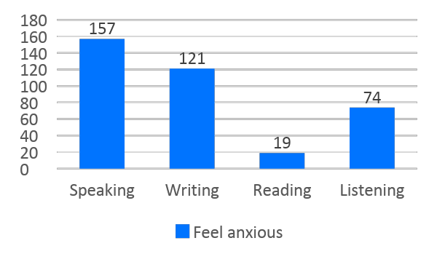
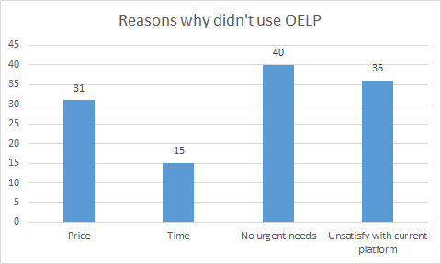
Taiwan Market Overview
Pain Points In Taiwan
Personal：feel anxious about English speaking and writing skills
Platform：nearly 30% of our respondents weren’t satisfy about current English learning platform in Taiwan
Notes:
So, what’s the problem or to say “unmet needs” in Taiwan OELP market?
From our survey, Taiwanese feel anxious about speaking and writing. And nearly 30% of our respondents, who are willing to learn english but not using OELP way, mentioned that they are not satisfied with current platform.

Slide 15
Taiwan Market Overview
Pain Points In Taiwan
MEDIATOR
Feel Anxious
towards Ability
IV
DV
MOTIVATION
to learn English
PURCHASE
or not
Notes:
Let’s move on to another model. If one purchase an online course, they might have some reason behind it, such as their motivation to learn English. For this reason, it became our main effect. Moreover, after digging our questionnaire, we found out that Anxious might affect the relationship of main effect. Hence, we use anxious towards ability as our mediator.

Slide 16
Taiwan Market Overview
Pain Points In Taiwan
IV
MEDIATOR
DV
MOTIVATION
to learn English
Feel Anxious
towards Ability
PURCHASE
or not
Test-oriented
Vocation-oriented
Travel-oriented
Friendship-oriented
Education-oriented
Personal Interest
Others
Speaking
Listening
Writing
Reading
YES
NO
Notes:
Before seeing the result, let me introduce the component of our variables. First is the motivation to learn English as our IV. We listed seven different orientations. As for mediator, there four dimensions, speaking listening writing and reading. Last but not least, DV represent whether purchase OELP or not.
After running the regression model, we found out that only test and travel oriented can cause the main effect with DV. And only Speaking can be the mediator in this regression model.

Slide 17
Taiwan Market Overview
Pain Points In Taiwan
Omnibus Tests Main Effect
 |  | Chi-square | df | Sig.
Model |  | 5.598 | 1 | 0.018
Omnibus Tests IV-M
 |  | Chi-square | df | Sig.
Model |  | 5.691 | 1 | 0.017
Omnibus Tests IV,M-DV
 |  | Chi-square | df | Sig.
Model |  | 8.85 | 2 | 0.012
β=-0.753*
Sig=0.021
MEDIATOR
β=0.817+
Sig=0.068
SPEAKING
Feel Anxious
IV
DV
TEST
Oriented
PURCHASE
or not
β=1.102* Sig=0.026
β’=1.021* Sig=0.042
Notes:
To test the mediation effect, there are three step procedure to follow. Please look at the chart on the left. The omnibus test of main effect has a p-value lower than .05, which indicate that the main effect does exist. The beta of the IV is 1.102. Moving on to Step 2, the middle chart shows that the omnibus tests of IV- mediation pass with the p-value of .017. Finally the last step, we combine IV and Mediation to run regression with DV. It also pass the omnibus test, which has the p-value of .012. After adding mediator, we can see that the beta decrease to 1.021.

Slide 18
Taiwan Market Overview
Pain Points In Taiwan
Omnibus Tests Main Effect
 |  | Chi-square | df | Sig.
Model |  | 4.611 | 1 | 0.032
Omnibus Tests IV-M
 |  | Chi-square | df | Sig.
Model |  | 8.897 | 1 | 0.003
Omnibus Tests IV,M-DV
 |  | Chi-square | df | Sig.
Model |  | 7.56 | 2 | 0.023
For those test and travel oriented English learner, feeling anxious of speaking English can enhance the probability of purchase OELP
β=-1.189*
Sig=0.007
MEDIATOR
β=0.776+
Sig=0.083
SPEAKING
Feel Anxious
PARTIAL
MEDIATION
IV
DV
TRAVEL
Oriented
PURCHASE
or not
β=1.221+ Sig=0.057
β’=1.076* Sig=0.098
Notes:
Hence, the mediator exist in this model with a partial mediation effect, which tells that for those test and travel oriented English learner, feeling anxious of speaking English can enhance the prob. of purchase OELP

Slide 19
Can Tella deal with them?
Yes, Tella can!!!

Slide 20
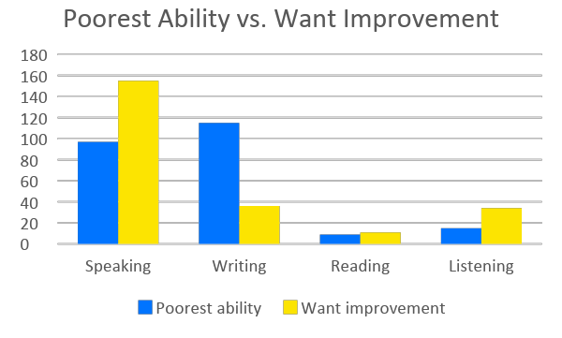
Taiwan Market Overview
Tella’s Unique Selling Point
Taiwanese has anxious feeling about English speaking and writing
Even poor in English writing, Taiwanese still want to improve English speaking
Only Tella provides both of the lessons of Speaking and writing!
Services Provided
Platform | Video Call | Audio Call | Text chat | Other Service
Tella |  | V | V | learning report (detailed)
TutorABC | V |  |  | customized material
EF | V |  |  | customized material
Engoo | V |  |  | online free sources
Cambly | V |  |  | learning report(record video)
Tella’s services have the advantage of differentiation, which combine both of English speaking and writing training. If Tella can convince customers to improve their writing, it’s an opportunity!
Notes:
To summarize tw market overview, we can see that

Slide 21
2C
Market
Strategy
STP Analysis & TA Persona
4P Analysis

Slide 22
MARKETING
STRATEGY
STP Analysis
Segmentation
Targeting
Positioning
- Benefit sought
- Age
- Attitude toward English
- Pursuing career growth & academic achievement
- 21-40 years old
- Anxious (Speaking & Writing)
- The most efficient and convenient way of practicing English oral and writing skills

Slide 23



MARKETING
STRATEGY
TA Persona
Age : 32 years old
Occupation : Executive of international company
Needs : Writing business e-mail to the headquarters
Pain Points : Feeling anxious about English writing
Age : 24 years old
Occupation : Graduated student applying for Master’s degree
Needs : Oral interview practice
Pain Points : Current English learning platform wasn’t satisfying
Age : 37 years old
Occupation : Free-lancer
Needs : English speaking & vocabulary when traveling
Pain Points : Love travel but can’t have conversations with foreigners

Slide 24



MARKETING
STRATEGY
4P Analysis - Product
Class Length
Frequency
Package length
31 - 45 mins per class
30 mins texting + 15 mins call
1 - 2 per week
1 / 3 / 6 / 12 month
Various Package !
Product
Price
Place
Promotion
Notes:
OK now let’s move onto 4P
First product, according to our survey we suggest Tella to provide 45 minutes per class including 30 minutes texting and 15 minutes call and take classes twice a week.
In addition, combining our research insight providing various package can satisfy TA from different age.

Slide 25
MARKETING
STRATEGY
4P Analysis - Product
CLASS LENGTH
Frequency
N = 136
N = 136
Option | Response
Below 15 mins | 11
16～30 mins | 43
31～45 mins | 55
Above 46 mins | 37
Option | Response
1～2 classes | 104
3～4 classes | 33
5～6 classes | 6
Above 7 classes | 3
Product
Price
Place
Promotion

Slide 26
MARKETING
STRATEGY
4P Analysis - Product
AGE X Preference of Product Design
AGE X PRICE/Month
AGE X CLASS LENGTH
AGE X FREQUENCY
AGE X PACKAGE LENGTH
Product
Price
Place
Promotion
Notes:
Moving on to our Research Insight. We want to know that if age can be the segmentation of Tella’s TA and is there any different opinion towards their preference of the Product design between different age group, which consist of price per month, class length, frequency in one week and the length per package. Thus we run the ANOVA analysis, and only package length has the different mean among ages.

Slide 27
MARKETING
STRATEGY
4P Analysis - Product
Cross Table - Age X Q11 Package Length
 | 11~20 | 21~30 | 31~40 | Above 40 | Total
Below 1 month | 4 | 13 | 5 | 2 | 24 | 10.17%
1-3 month | 32 | 65 | 6 | 1 | 104 | 44.07%
4-6 month | 17 | 38 | 4 | 0 | 59 | 25.00%
6-12 month | 6 | 13 | 3 | 2 | 24 | 10.17%
Above 12 month | 6 | 13 | 6 | 0 | 25 | 10.59%
Total | 65 | 142 | 24 | 5 | 236 | 100.00%
ANOVA-Age X Q11 Package Length
 | Sum of Squares | df | Mean Square | F | Sig.
Between Groups | 224.671 | 3 | 74.89 | 5.068 | 0.002
Within Groups | 3427.986 | 232 | 14.776
Total | 3652.657 | 235
Product
Price
Place
Promotion
Notes:
From the cross table, we can see the distribution of their choice.

Slide 28
MARKETING
STRATEGY
4P Analysis - Product
Post Hoc Test
(I) Age |  | Mean Difference (I-J) | Std. Error | Sig. | 95% CI |  | (I) Age |  | Mean Difference (I-J) | Std. Error | Sig. | 95% CI
 |  |  |  |  | Lower Bound | Upper Bound |  |  |  |  |  | Lower Bound | Upper Bound
11~20 | 21~30 | -0.305 | 0.576 | 0.596 | -1.44 | 0.83 | 31~40 | 11~20 | 2.989* | 0.918 | 0.001 | 1.18 | 4.8
 | 31~40 | -2.989* | 0.918 | 0.001 | -4.8 | -1.18 |  | 21~30 | 2.684* | 0.848 | 0.002 | 1.01 | 4.36
 | Above 41 | -3.831* | 1.784 | 0.033 | -7.35 | -0.32 |  | Above 41 | -0.842 | 1.89 | 0.656 | -4.56 | 2.88
21~30 | 11~20 | 0.305 | 0.576 | 0.596 | -0.83 | 1.44 | Above 41 | 11~20 | 3.831* | 1.784 | 0.033 | 0.32 | 7.35
 | 31~40 | -2.684* | 0.848 | 0.002 | -4.36 | -1.01 |  | 21~30 | 3.525* | 1.749 | 0.045 | 0.08 | 6.97
 | Above 41 | -3.525* | 1.749 | 0.045 | -6.97 | -0.08 |  | 31~40 | 0.842 | 1.89 | 0.656 | -2.88 | 4.56
*. The mean difference is significant at the 0.05 level.
Product
Price
Place
Promotion
Notes:
From the cross table, we can see the distribution of their choice.

Slide 29
MARKETING
STRATEGY
4P Analysis - Product
Cross Table - Age X Q11 Package Length
 | 11~20 | 21~30 | 31~40 | Above 40 | Total
Below 1 month | 4 | 13 | 5 | 2 | 24 | 10.17%
1-3 month | 32 | 65 | 6 | 1 | 104 | 44.07%
4-6 month | 17 | 38 | 4 | 0 | 59 | 25.00%
6-12 month | 6 | 13 | 3 | 2 | 24 | 10.17%
Above 12 month | 6 | 13 | 6 | 0 | 25 | 10.59%
Total | 65 | 142 | 24 | 5 | 236 | 100.00%
Tella should provide various package length to satisfy customer from different age
Product
Price
Place
Promotion

Slide 30
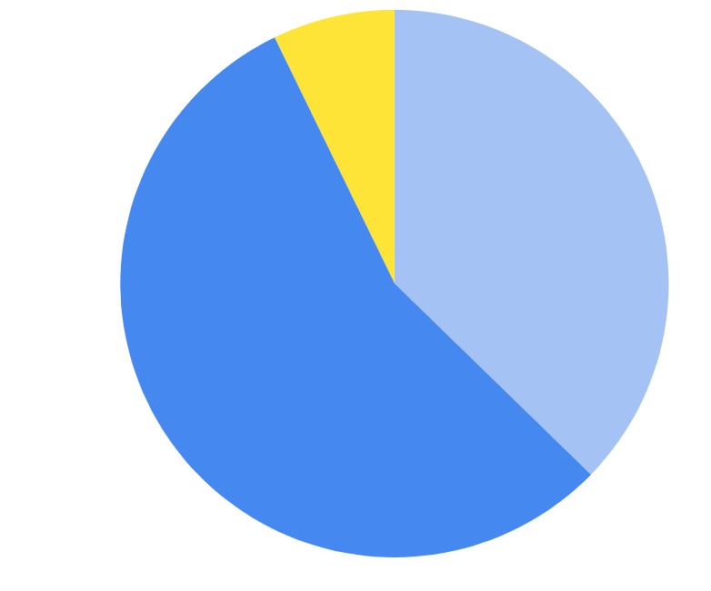
MARKETING
STRATEGY
4P Analysis - Product
Q12 Please arrange the following options according to your preference of your
English tutor?
N = 236
Option | Response
Native Speaker | 88
Full of Experiences | 131
TESL/TESOL | 17
Tella should emphasize each teacher’s teaching experience.
Native Speaker
Full of Experiences
TESL/TESOL
Product
Price
Place
Promotion
Notes:
Improving teachers’ experiences is an important task

Slide 31
MARKETING
STRATEGY
4P Analysis - Price
46.57% willing to pay < $1500
Writing + Speaking
35.62 % willing to pay $1501 - $3000
Competitors’ price fell in
$1501 - $3000
Product
Price
Place
Promotion
Notes:
Second price, although more respondents choose the lower one but we think that Tella can target on the higher one because Tella provides service of writing and speaking, and the competitors’ price also fell in this range.

Slide 32

MARKETING
STRATEGY
4P Analysis - Place
The most domain communication app in Taiwan
90% of market penetration rate
Integrate with Line pay
Need a Taiwanese website
Resources : Appendix
Product
Price
Place
Promotion
Notes:
Third place, Line is the platform we suggest due to these reasons: market penetration, line pay etc. Also setting up a Taiwanese website will be more convenient for user as well.

Slide 33
MARKETING
STRATEGY
4P Analysis - Promotion
CORE VALUE - The most efficient and convenient way of practicing English oral and writing skills
Use CEO interview and media pitch to raise awareness
Use Facebook AD and Video AD to raise the awareness, especially brand awareness
Through Friend persuasion, raising the interest, trial and adoption
By Email, phone call and official account raising the interest, evaluation and trial
Product
Price
Place
Promotion
Notes:
Last promotion, this chart includes IMC in different stage of innovation adoption model.

Slide 34
MARKETING
STRATEGY
4P Analysis - Promotion
Q15. Research has shown that text learning is better than voice. Would you choose text learning for this reason?
Tella can emphasize the effectiveness of text-learning method in advertising.
N = 177
Option | Response
Yes | 110
No | 67
69.1% willing to learn by text
Product
Price
Place
Promotion

Slide 35
MARKETING
STRATEGY
4P Analysis - Promotion
IMPORTANCE of Consideration towards OELP X Further Action
Importance
of consideration
DV
Further Action
or not
IV
Price
Quality
Trial Quality
Teaching method
Customization
CP Ratio
Operation convenience
Rating
Reputation Flexibility
Flexibility
Personal Feedback
Replay function
Refund
YES
Purchase directly
Enroll trial and purchase
Enroll trial but not purchase
NO
Product
Price
Place
Promotion
Notes:
In our survey, we asked the respondent about the importance of consideration of OELP, and also further action after searching OLEP. We want to find out that which consideration can be the cause to make customer to have further action.
There are 13 different considerations when they’re evaluating the performance of OELP, on the other hand, their might develop three kinds of further action, which listed on the right side. If they didn’t have the further action, they would reply no.
Because of the DV is a yes no question, so we use logistic regression to run the model.
Price
Quality
Trial Quality
Teaching method (e.g. video, verbal, text…etc)
Customization
Cost-Performance Ratio
Rating
Reputation Flexibility (e.g. various program)
Flexibility
operation convenience
Personal Feedback (如：英文進步程度分析等)
Replay function
Refund

Slide 36
MARKETING
STRATEGY
4P Analysis - Promotion
IV
Omnibus Tests Main Effect
 |  | Chi-square | df | Sig.
Model |  | 7.4296 | 1 | 0.0023
Accuracy Ratio
64.42%
DV
Importance
Consideration
Further Action
or not
 | Beta | Z-value | Sig. | EXP(B) | vif
Constant | 1.4100 | 1.200 | 0.229
CP Ratio | -0.6082 | -2.364 | 0.018 * | 0.5443 | 1.2887
Replay | -0.5918 | -2.771 | 0.005** | 0.5533 | 1.4333
Operation Convenience | 0.4524 | 2.104 | 0.035* | 1.5721 | 1.3324
Refund | 0.4208 | 1.936 | 0.052+ | 1.5232 | 1.5726
Tella can strengthen the performance of
Operation convenience and Refund in advertising.
Product
Price
Place
Promotion
Notes:
This is the result of logistic regression, we can see that it pass the omnibus test with the p-value lower than 0.05, which means that the regression line exists. From the chart, we can see that there are four of 13 consideration are included in this equation.
Let’s take a look at the beta of the four variables. CP Ratio and Replay has a negative beta, which means their exp(B) are below one. We can tell that these two decrease 46% and 45% of prob. to have further action. For OC and refund has positive beta, their exp(B) are above one. It shows that these two increase 57% and 52% of prob. to have further action.
As a result, we can conclude that OC and Refund will trigger customer to make further action. And Tella can strengthen the performance of Operation convenience and Refund in advertising.
Operation convenience and Refund
will trigger customer to have further action

Slide 37
2B
Market
Strategy
Research Method
2B Qualitative Research Insight

Slide 38
2B Market
Qual. Interview
Qualitative Research Method
Research method | In-Depth Interview
Respondent | Employees / HR / CEO
Sample Profile | 15 companies 11 Taiwan local companies 4 foreign companies Employees: Below 100: 3, 100-300: 3, 301-500: 3, 1000+: 6
Survey design | Current needs for English Ideal function of OELP
Industry Category | Tech, Trade, Real Estate, Startup, Med, Tutorial Institute
Interview with 15 interviewees
Age: from 23 to 30 (14), 50+ (1)
11 Taiwan local companies, 4 foreign companies
40% of company provide free resources for employees to enhance their English skills, and 60% of which also provide education allowances.
•產業類別(Need more information)
• 橫跨：科技業、貿易業、房仲業、新創、醫藥產業、補教業、軟體業

Slide 39
2B Market
Insights
2B Qual. Research Insights
Tella’s Potential 2C TA
“ As a nurse, when foreign patients come, I need to explain some disease information to them, and sometimes I just ask the physician to take the job.” - Miss Hsu, Nurse, Medical industry
Japan
China Singapore Malaysia
TW Local Company
Tella’s 2B TA
“ Due to COVID 19, our teacher can’t deliver courses physically but we still want to keep developing western clients. Thus, we are willing to try digital way but need more discussion.” - Miss Huang, Training HR, Computers and Peripheral Equipment Manufacturing
Non Tella’s
TA
(2/15)
Tella’s Potential 2C TA
(1/15)
Tella’s
2B TA
(3/15)
Tella’s 2C TA
Need to communicate in written or speaking English
“One of a must to get promoted in my company is fluent English.” - Mr. Pan, MKT Spclst, Pharma. Industry
“I would like to improve my English for all my colleagues are good at it and I need to communicate in English with some clients.” - Miss Lu, Operation Spclst,
Alcoholic Beverages Manufacturing
Global business
Tella’s
2C TA
(2/15)

Slide 40
Conclusion
Notes:
And our conclusion is that in 2B market Tella can contact more sales in local company and in 2C market Tella can refer our marketing strategy and create one.
We believe that Tella can enter Taiwan market successfully.

Slide 41

Conclusion
2B
If Tella wants to enter TW 2B market, it needs to find customer satisfied with:
TW local company
Global business
Needs oral and writing English
2C
Product
31 - 45 mins per class
1 - 2 classes per week
Various Package
Price
NT$1,501~3,000/month
Place
Line, Taiwan website
Promotion
Use IMC to fulfill the innovation adoption model

Slide 42
THANKS FOR LISTENING
TEAM 3
OF
TEAM 3
106305015 Ansel
105509210 Jennifer
105305011 Sonia
106301072 Jane
105208043 Hazel

Slide 43
Appendix

Slide 44
Appendix
Resources
http://teldap.tw/Introduction/introduction.html
https://www.ey.gov.tw/Page/5A8A0CB5B41DA11E/087b4ed8-8c79-49f2-90c3-6fb22d740488
https://www.digitimes.com.tw/iot/article.asp?cat=158&id=0000572200_faf3nf66lcl1vz1ykq1y5
https://meethub.bnext.com.tw/voicetube-%E5%85%AC%E5%B8%83%E3%80%8A2019-%E5%9C%8B%E4%BA%BA%E8%8B%B1%E6%96%87%E8%AA%BF%E6%9F%A5%E5%A0%B1%E5%91%8A%E3%80%8B%EF%BC%9A%E7%96%AB%E6%83%85%E5%B8%B6%E5%8B%95%E7%B7%9A%E4%B8%8A%E8%AA%9E/

